Slide 1

HoneycombOnArm64MacOS
Installation Guide
Honeycomb Bravo configuration plugin for MacOS
Native Apple Silicon
For X-Plane 12
OpenSource
Run X-Plane 12 Apple Silicon compatible aircraft with Honeycomb Bravo controls, without needing Rosetta
© Dr Steve Proctor 2024
swp336@gmail.com
Installation Guide vBeta1.02

Slide 2
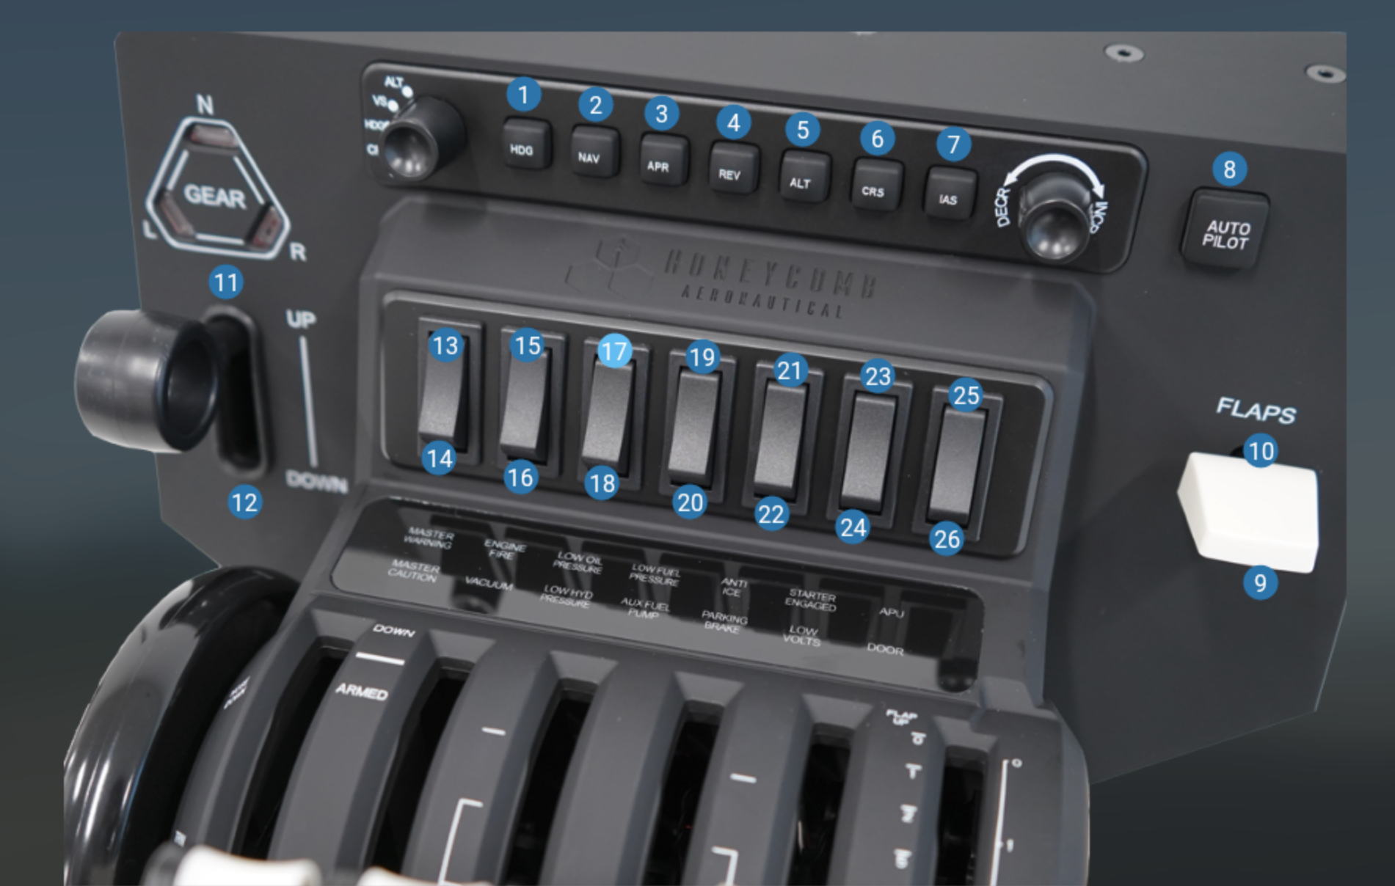
HoneycombOnArm64MacOS
Features
Assign commands for all rotary controls
Assign commands for all autopilot buttons
Assign datarefs for all annunciator lights
Assign datarefs for all autopilot button lights
Use Bravo switches to modify rotary and button behaviour
Built-in configs for all Laminar Research supplied aircraft
Uses JSON files to read/modify/create configs
© Dr Steve Proctor 2024
swp336@gmail.com
Installation Guide vBeta1.02

Slide 3
First-time install
HoneycombOnArm64MacOS
Installation 1
This installation step for a first-time install. If you are upgrading from a previous version of the plugin, please go here for the upgrade process.
Copy the Honeycomb directory to X-Plane 12/Resources/plugins
Open a terminal and go to the plugin directory.
Usually cd “<your user area>/X-Plane \12/Resources/plugins”
Run command "xattr -dr com.apple.quarantine ./Honeycomb”
Start x-plane (in apple silicon native mode)
© Dr Steve Proctor 2024
swp336@gmail.com
Installation Guide vBeta1.02

Slide 4
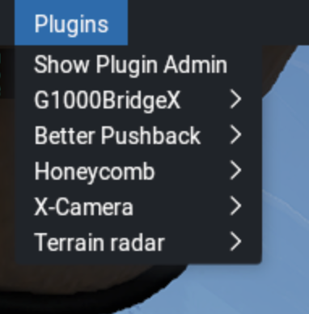
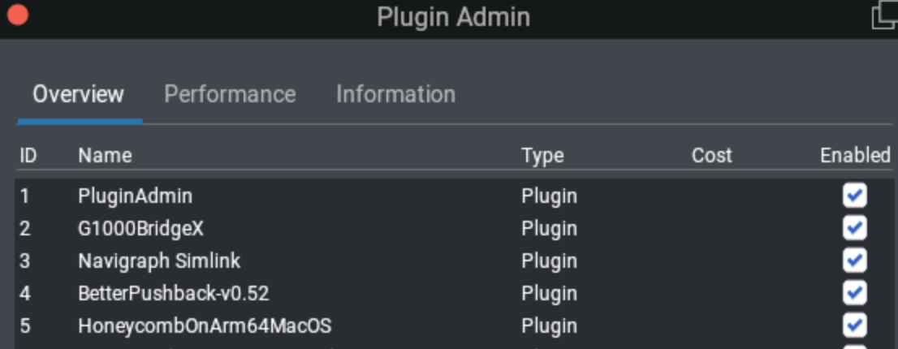
HoneycombOnArm64MacOS
Installation 2
In x-plane select your aircraft and start your flight
Go to the plugin menu and verify the Honeycomb plugin is present
© Dr Steve Proctor 2024
swp336@gmail.com
Installation Guide vBeta1.02

Slide 5
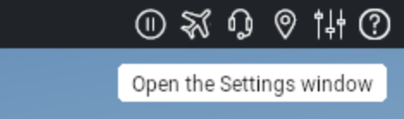
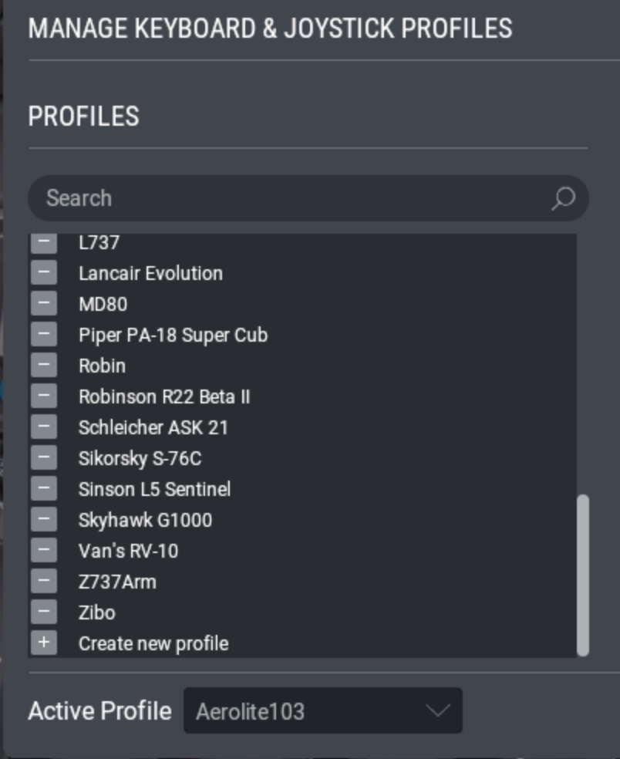
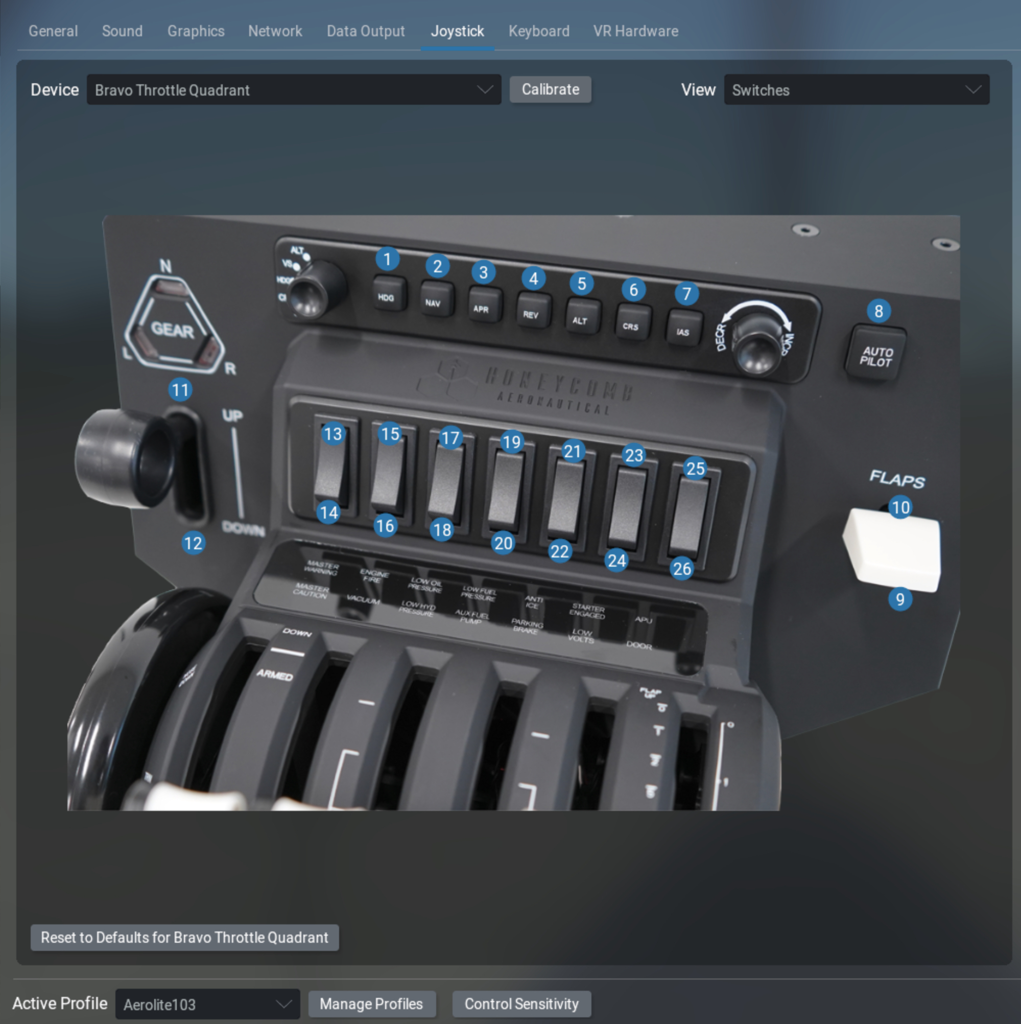
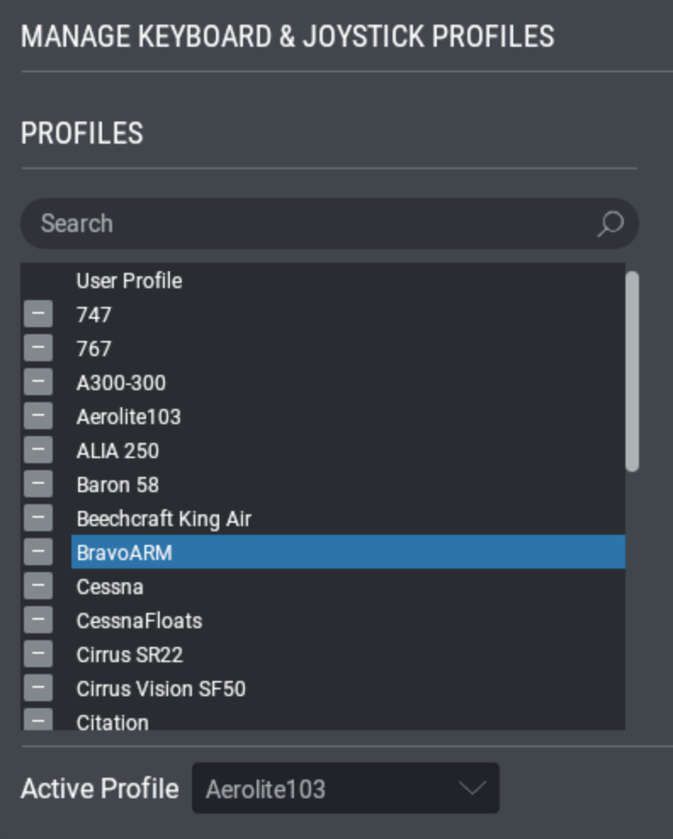
1
HoneycombOnArm64MacOS
Installation 3
Open the x-plane settings window
Select the joystick tab
Select the Bravo Throttle
Click ‘Manage Profiles’
Click ‘+’ to “Create new profile”
Call it something like BravoARM*
This profile will become the base config required for the plugin to work correctly and will be copied to each new aircraft that wants to use the plugin. The following pages describe how to set up the base config and how to apply it to each aircraft
2
3
5
4
6
*This can be any name you choose, it’s the base config that will be copied to all your aircraft using this plugin
© Dr Steve Proctor 2024
swp336@gmail.com
Installation Guide vBeta1.02

Slide 6
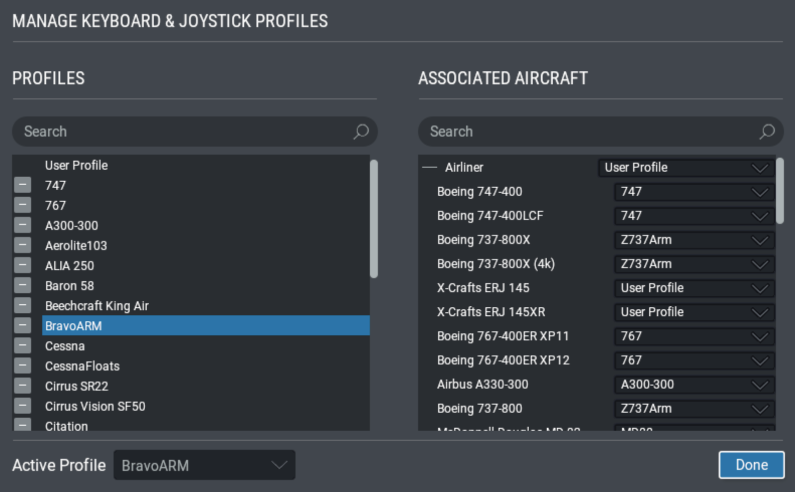
HoneycombOnArm64MacOS
Installation 4
The next step will take a few minutes, but only is only done once. During this step you will assign a plug-in reference to every Bravo button, toggle and rotary control. This enables the plug-in to respond to every button press, toggle press or rotary click and apply the correct command based on the plane’s configuration profile
Ensure the steps on the previous page have been completed
Select the new base config in the ‘Active Profile’ dropdown
Press ‘Done’
Go to the next page
1
2
© Dr Steve Proctor 2024
swp336@gmail.com
Installation Guide vBeta1.02

Slide 7
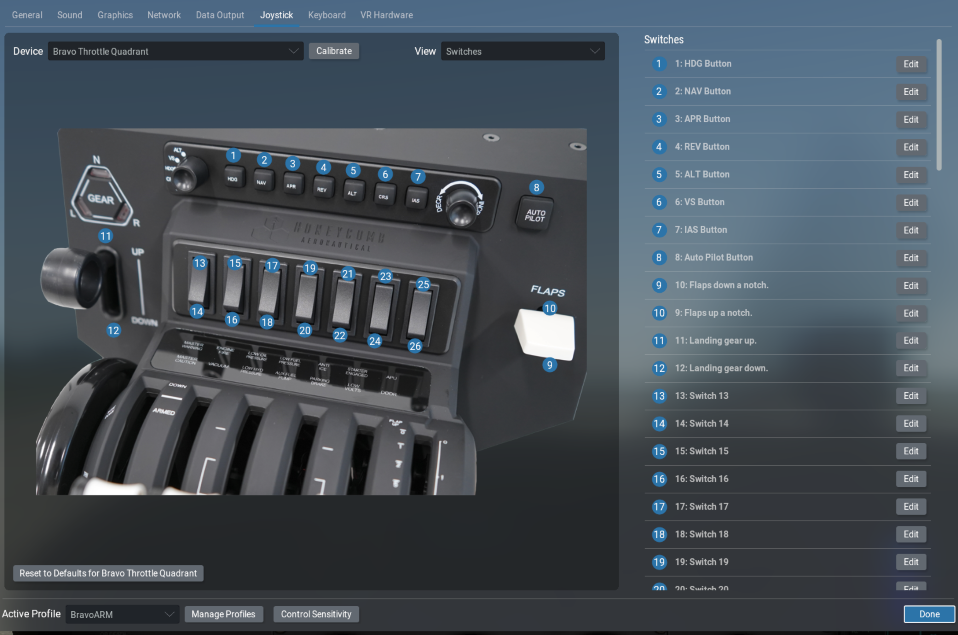
HoneycombOnArm64MacOS
Installation 5
Ensure the steps on the previous page have been completed
Click on the ‘Edit’ button for Switch 1
Go to the next page
*
1
*Ignore these values for now. Your config may look very different at this point. However, this is what it will look like when you have completed the current setup steps.
© Dr Steve Proctor 2024
swp336@gmail.com
Installation Guide vBeta1.02

Slide 8
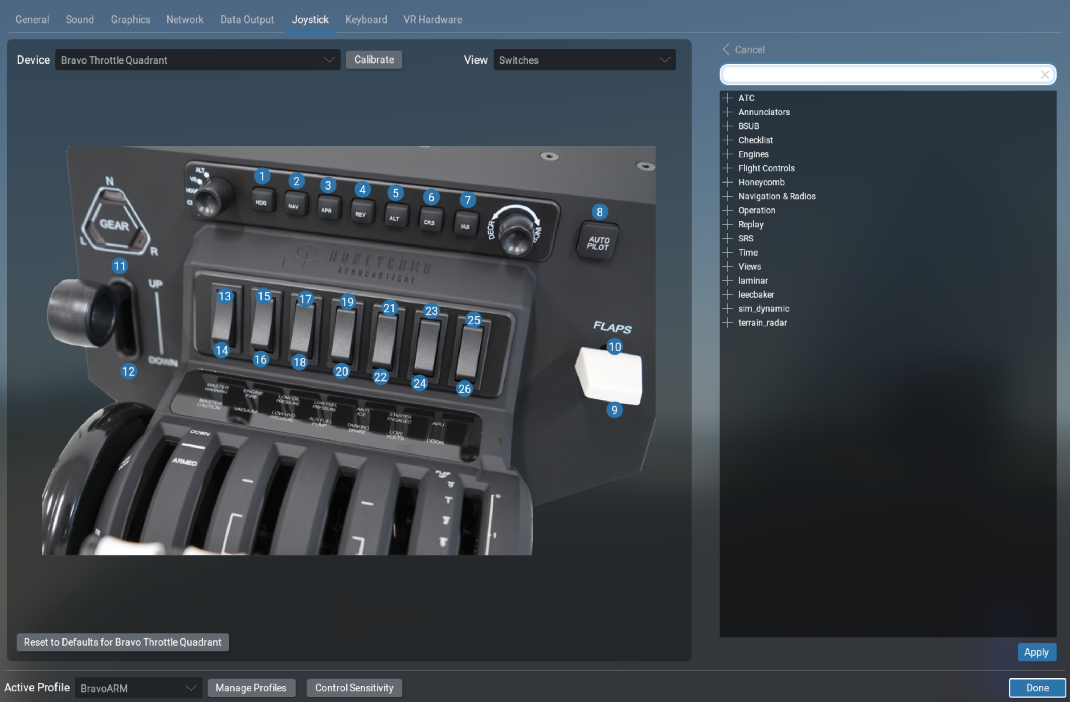
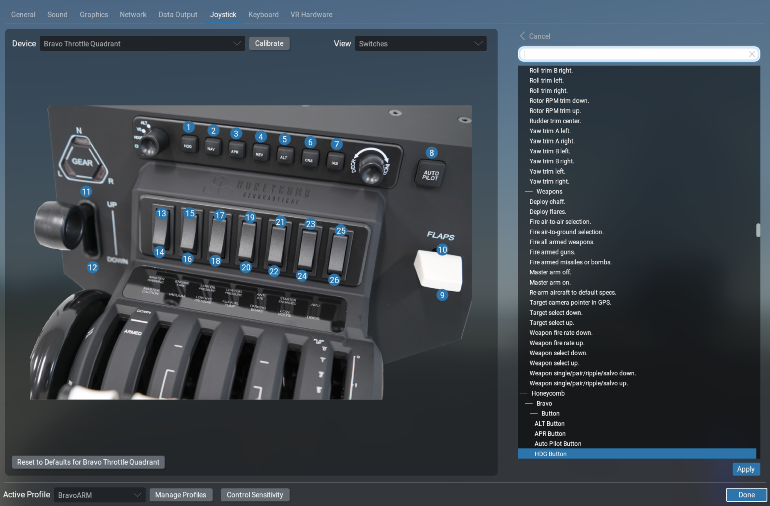
HoneycombOnArm64MacOS
Installation 6
Ensure the steps on the previous page have been completed
On my mac the command list always appears in a random order. To fix this
Enter a single character in the search box, then delete it.
This rearranges everything in hierarchical order, making it
much easier to find the right Honeycomb command
Click the ‘+’ next to Honeycomb and explore the structure underneath
Go to the next page
2
1
© Dr Steve Proctor 2024
swp336@gmail.com
Installation Guide vBeta1.02

Slide 9
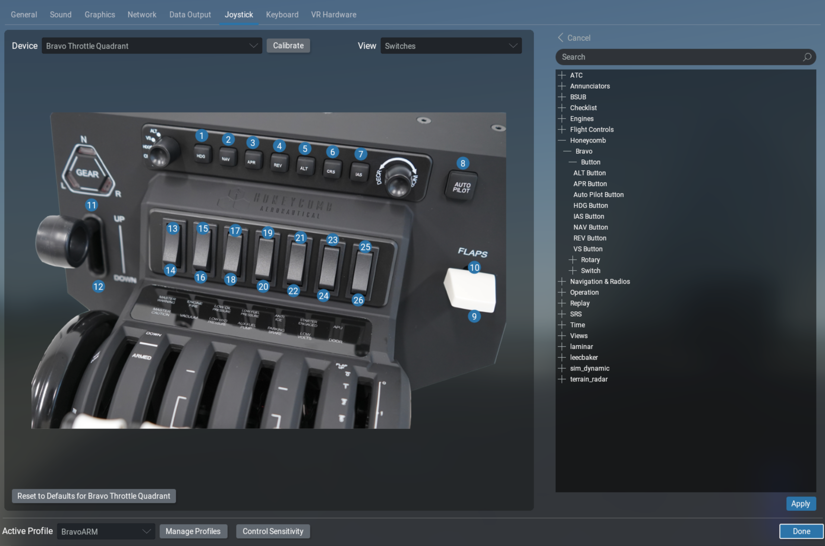
HoneycombOnArm64MacOS
Installation 7
Ensure the steps on the previous page have been completed
Select the HDG Button option
Click apply
Go to the next page
1
2
© Dr Steve Proctor 2024
swp336@gmail.com
Installation Guide vBeta1.02

Slide 10
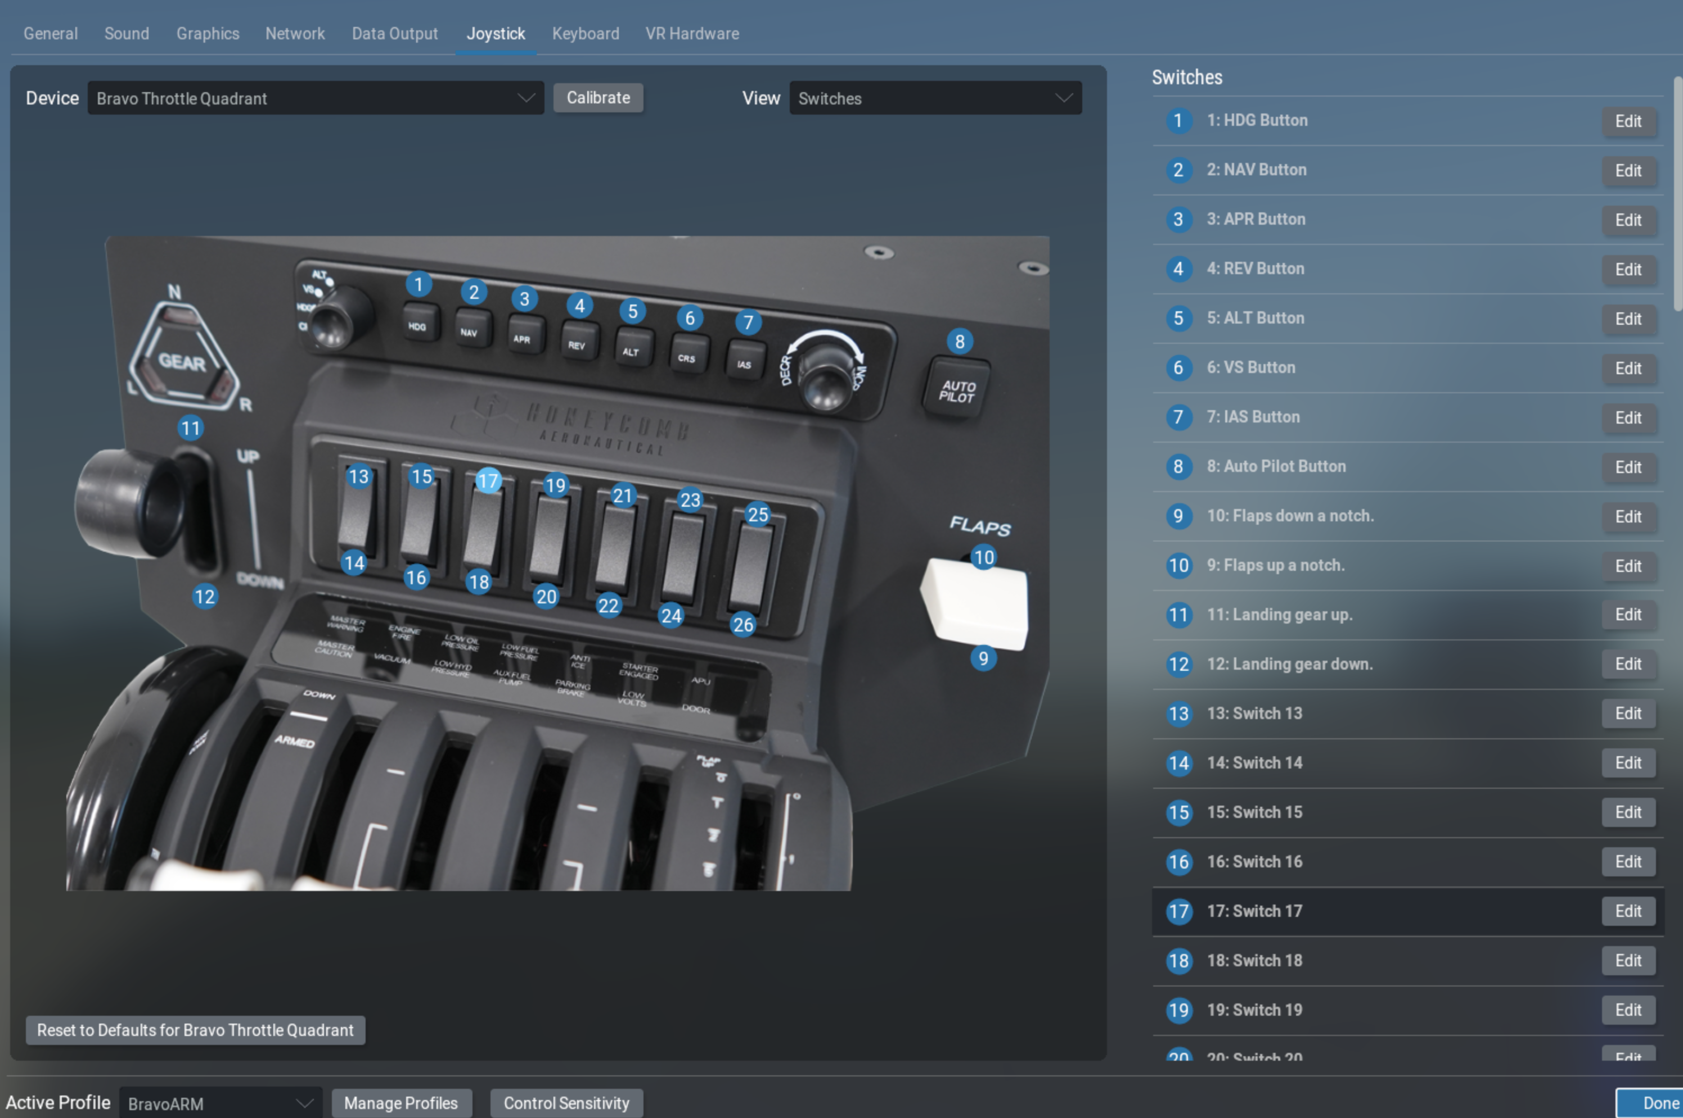
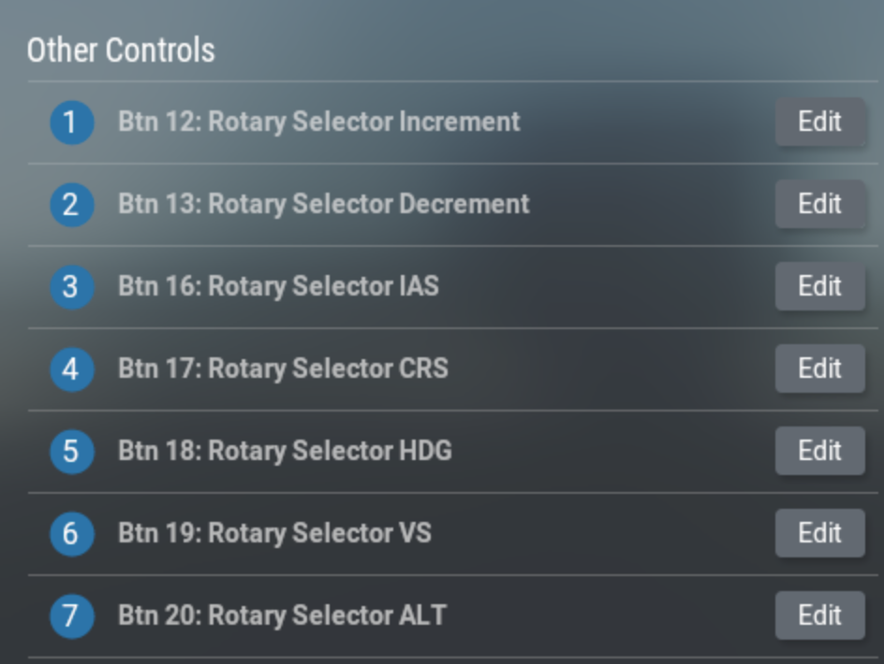
HoneycombOnArm64MacOS
Installation 8
1
Ignore 9-12 for now, these are not
controlled by the plugin
3
2
Repeat installation steps 5, 6, 7 for
each of the eight autopilot buttons
all switches 13-26
the increment and decrement rotary
the function selector rotary
4
© Dr Steve Proctor 2024
swp336@gmail.com
Installation Guide vBeta1.02

Slide 11
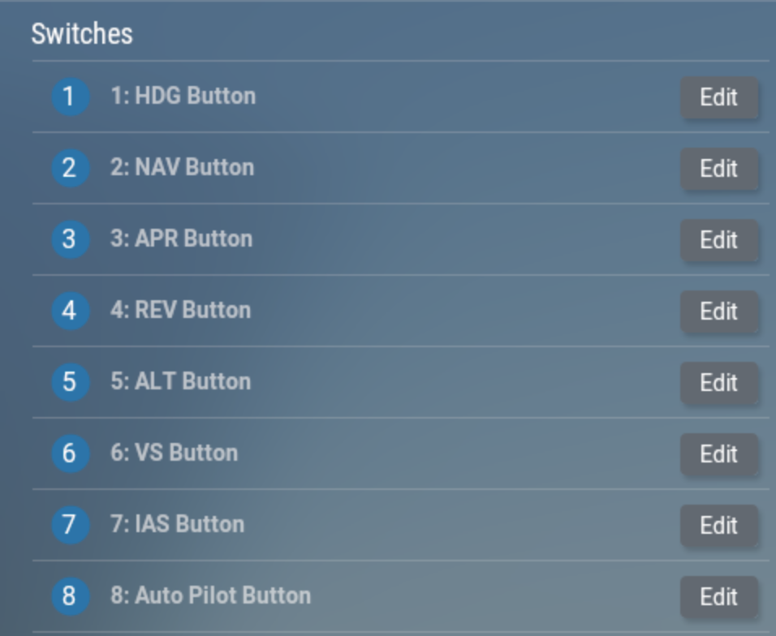
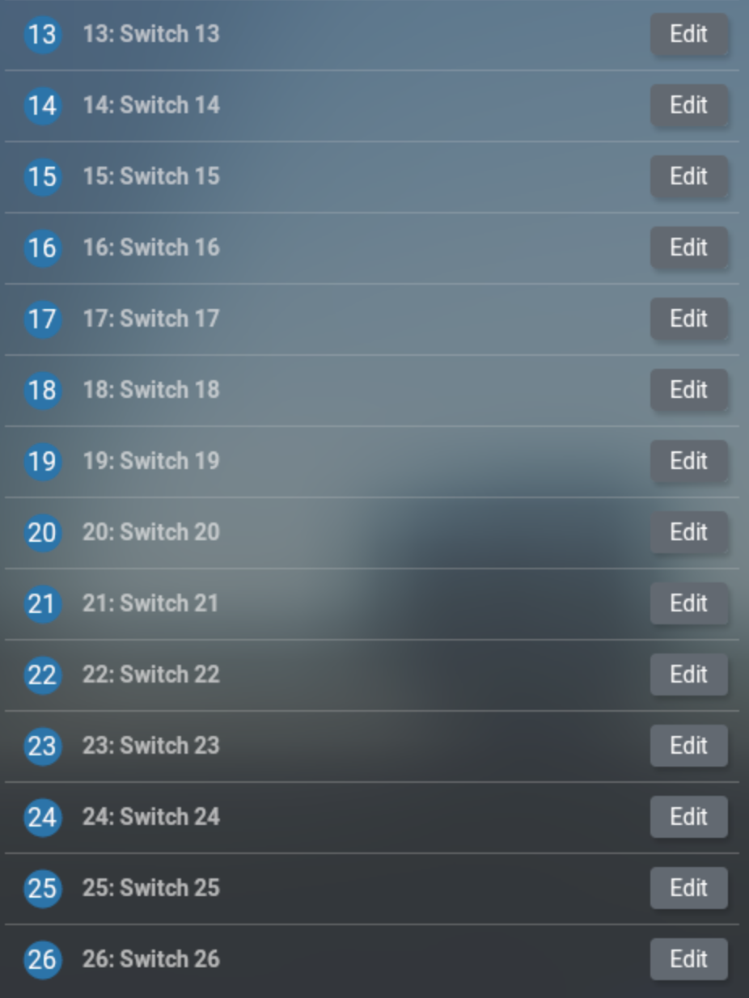
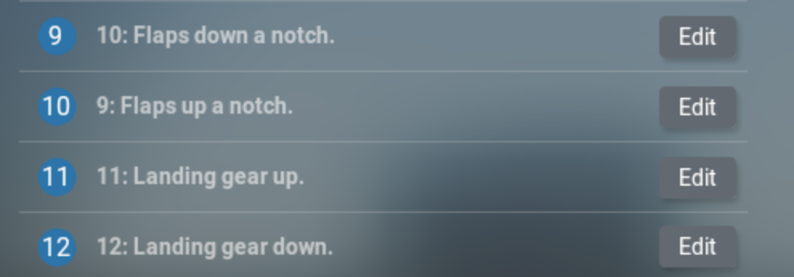
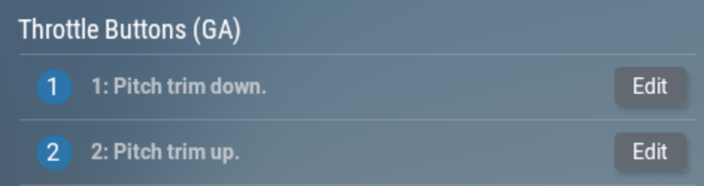
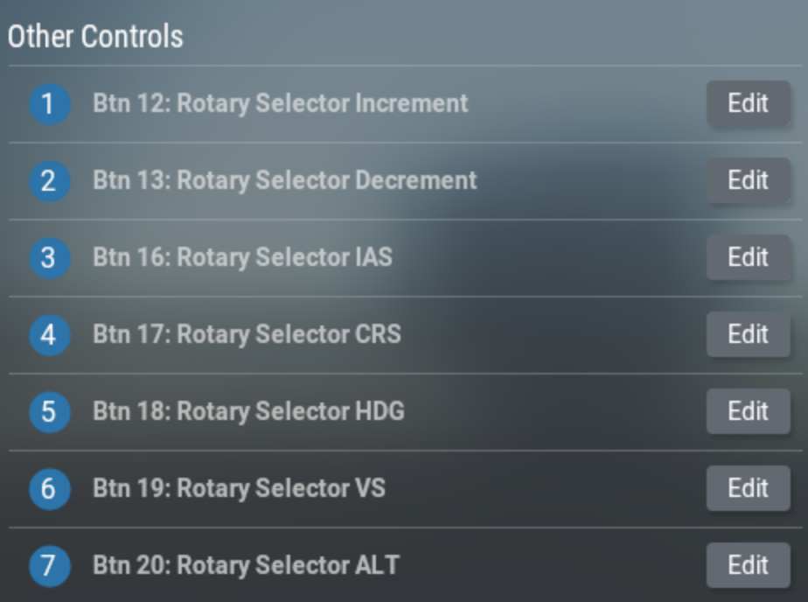
Installation 9
Installation 8a
Make sure the previous step has assigned all the green-box items in your new base config (BravoArm or whatever you named it). Anything missing or mis-configured from the green box will case unexpected plug-in behaviour. The plug-in only manages the Bravo controls listed in the green box, Any other controls can be assigned any value you wish. This includes the blue box items below, however the blue-box controls are commonly assigned to these commands, so may be useful to include in your base config.
HoneycombOnArm64MacOS
© Dr Steve Proctor 2024
swp336@gmail.com
Installation Guide vBeta1.02

Slide 12
Installation 9
Installation 9
Final step for this first aircraft
Ensure the new base config is selected in the ‘Active Profile’ dropdown (see Installation 4, graphic 1)
Click the ‘Manage profiles’ button at the bottom of the config window (see Installation 3, graphic 4)
Scroll to the bottom on the left-hand pane and click on ’Create new profile’ (see installation 3, graphic 5)
Give the new profile a suitable name for this aircraft*
This creates a new profile specific to this aircraft, incorporating all the assignments from the base
config
Ensure the new aircraft profile is assigned to this aircraft in the right-hand pane (see Installation 4, graphic 2)
Ensure the new aircraft profile is selected in the Active Profile box
Click ‘Done’ (see Installation 4, graphic 2)
Complete the plane’s control assignments for throttle controls, flap controls, Gear up/down controls
etc in the usual way.
Go Fly - see user guide for information on using the plugin assigned controls
This completes the plug-in installation and the setup of your first aircraft (see next page for configuring other aircraft
to use the plugin).
HoneycombOnArm64MacOS
*If you intend using both the ARM plugin and the Bravo Manufacturer’s own AFC_Bridge plugin for the same aircraft, then in step 4 you need to give this profile a distinctive name (e.g., add ‘ARM’ to the end) so you can select it when using the ARM plugin. The AFC_bridge will need its own profile for this aircraft. See here for further information on AFC_Bridge co-existence
© Dr Steve Proctor 2024
swp336@gmail.com
Installation Guide vBeta1.02

Slide 13
Installation 10
Configuring the 2nd aircraft and beyond to use the plug-in
Start your flight with an aircraft not previously configured to use the plug-in
Open the x-plane settings window at the joystick tab
Select the Bravo Throttle
Select the BravoArm profile
Follow the instructions on the previous page to create a new profile
for this new aircraft
Go Fly - see user guide for information on using the plugin assigned controls
HoneycombOnArm64MacOS
© Dr Steve Proctor 2024
swp336@gmail.com
Installation Guide vBeta1.02

Slide 14
AFC_Bridge compatibility
Installation - compatibility with AFC_Bridge
AFC_Bridge is the plugin from Honeycomb Aeronatical, manufacturers of the Bravo throttle control and Alpha yoke. AFC_Bridge is primarily a windows configuration tool but a version runs on intel macs and can also run on apple silicon macs under Rosetta. Note, running a plug-in under Rosetta means X-Plane must also run under Rosetta, which can significantly degrade performance and frame-rate on an Apple Silicon Mac.
The HoneycomOnArm64 plugin described in this document can be installed alongside
AFC_bridge on an apple silicon mac as they are mutually exclusive. When X-Plane is run
in intel mode using Rosetta, it will pick up the AFC_Bridge plugin. When run in native
apple silicon mode it will pick up the HoneycomOnArm64 plugin.
The json files used by HoneycombOnArm64 and AFC_Bridge are bespoke to each plugin
and are not interchangeable. If you run both plugins, they each require their own json
configuration file per aircraft. They will also require their own aircraft profile within X-Plane.
HoneycombOnArm64MacOS
© Dr Steve Proctor 2024
swp336@gmail.com
Installation Guide vBeta1.02

Slide 15
Upgrade process
Upgrading from a previous version – no custom json files
If you have not made edits to any of the default json files and have not created your own custom json files then
1. delete the Honeycomb directory X-Plane 12/Resources/plugins/Honeycomb
2. Follow the steps for a first-time install - only requires Installation steps 1 & 2
If you want to keep your custom json file, then see the next page
HoneycombOnArm64MacOS
© Dr Steve Proctor 2024
swp336@gmail.com
Installation Guide vBeta1.02

Slide 16
Upgrading from a previous version – keep custom configs
You have two options:
take a copy of your custom json files
delete the Honeycomb directory
follow the first-time install process - only requires Installation steps 1 & 2
copy your json files back to the Honeycomb directory
OR
Keep the Honeycomb directory
delete the mac_x64 directory and replace with the new version
delete the Documentation directory and replace with the new version
Open a terminal and go to the plugin directory
Usually cd “<your user area>/X-Plane \12/Resources/plugins”
Run command "xattr -dr com.apple.quarantine ./Honeycomb”
HoneycombOnArm64MacOS
© Dr Steve Proctor 2024
swp336@gmail.com
Installation Guide vBeta1.02

Slide 17
HoneycombOnArm64MacOS
End of Installation Guide
© Dr Steve Proctor 2024
swp336@gmail.com
Installation Guide vBeta1.02

